Slide 1
Computer vision: models, learning and inference
Chapter 9
Classification Models

Slide 2
Structure
Logistic regression
Bayesian logistic regression
Non-linear logistic regression
Kernelization and Gaussian process classification
Incremental fitting, boosting and trees
Multi-class classification
Random classification trees
Non-probabilistic classification
Applications
Computer vision: models, learning and inference. ©2011 Simon J.D. Prince
2

Slide 3
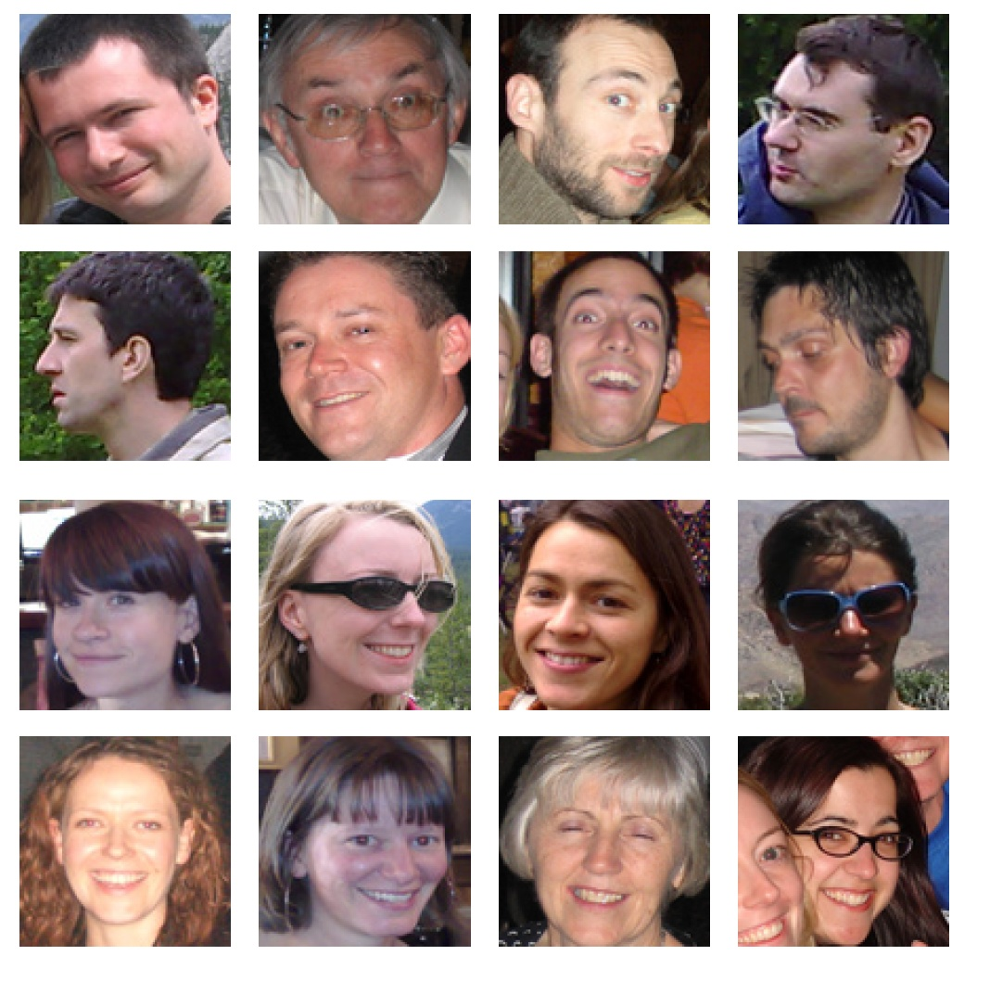
Example application: Gender Classification
Computer vision: models, learning and inference. ©2011 Simon J.D. Prince
3

Slide 4
Type 1: Model Pr(w|x) - Discriminative
How to model Pr(w|x)?
Choose an appropriate form for Pr(w)
Make parameters a function of x
Function takes parameters θ that define its shape
Learning algorithm: learn parameters θ from training data x,w
Inference algorithm: just evaluate Pr(w|x)
Computer vision: models, learning and inference. ©2011 Simon J.D. Prince
4

Slide 5
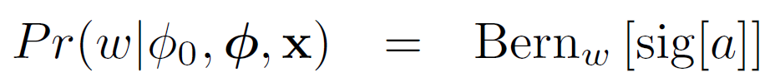
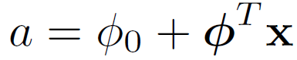
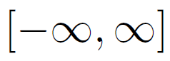
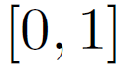
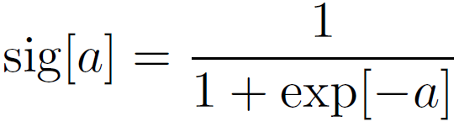

Logistic Regression
Consider two class problem.
Choose Bernoulli distribution over world.
Make parameter λ a function of x
Model activation with a linear function
creates number between . Maps to with
Computer vision: models, learning and inference. ©2011 Simon J.D. Prince
5

Slide 6
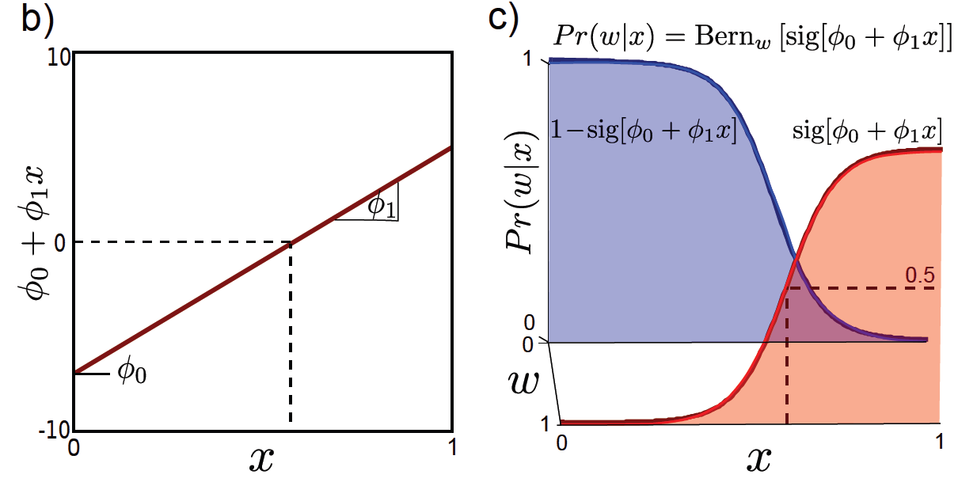
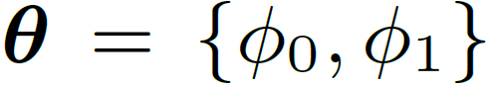
Two parameters
Learning by standard methods (ML,MAP, Bayesian)
Inference: Just evaluate Pr(w|x)

Slide 7
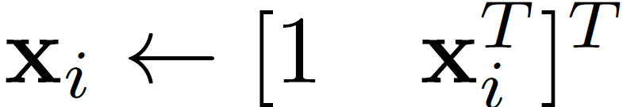
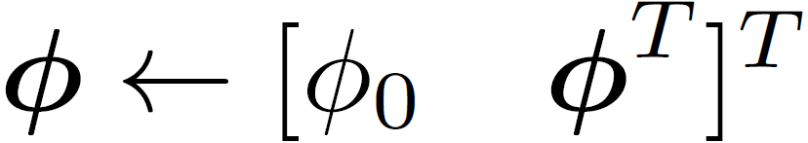
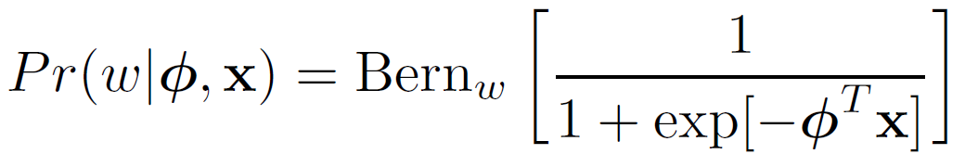
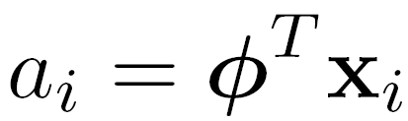


Neater Notation
To make notation easier to handle, we
Attach a 1 to the start of every data vector
Attach the offset to the start of the gradient vector φ
New model:
Computer vision: models, learning and inference. ©2011 Simon J.D. Prince
7

Slide 8
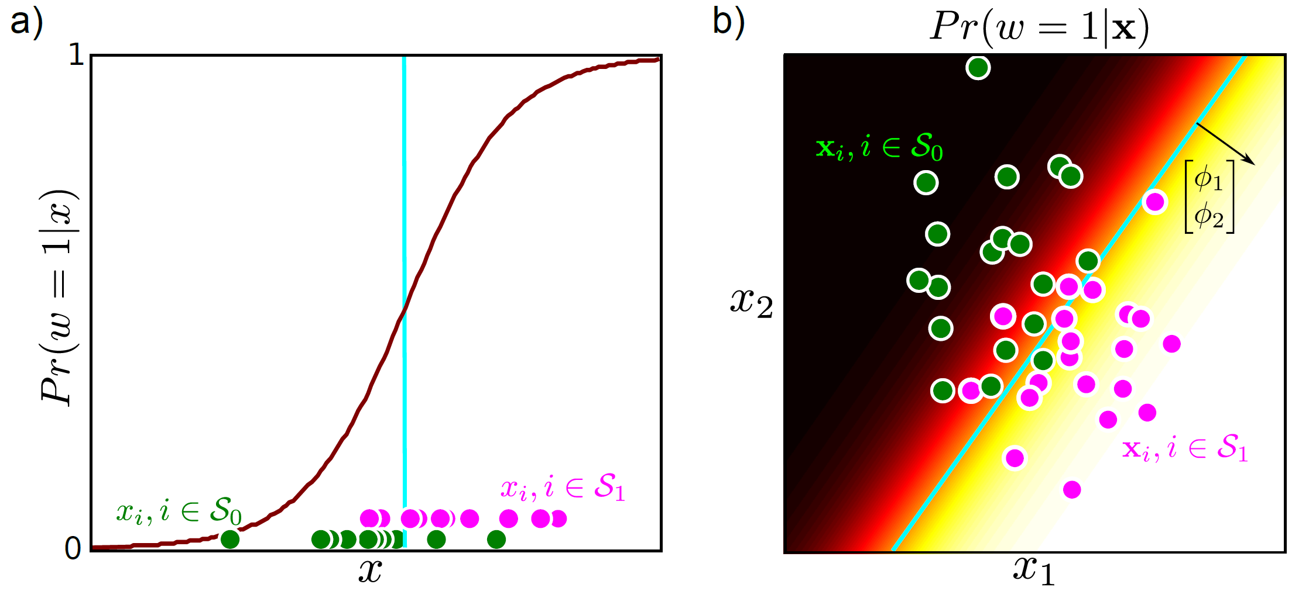



Logistic regression
Computer vision: models, learning and inference. ©2011 Simon J.D. Prince
8

Slide 9
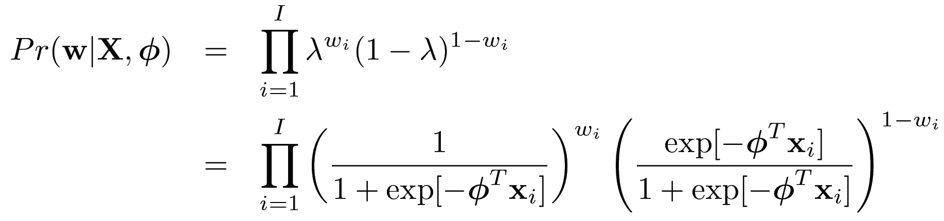
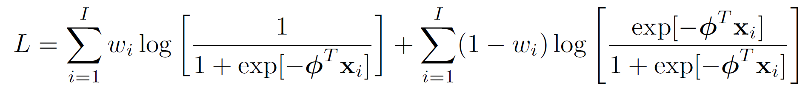
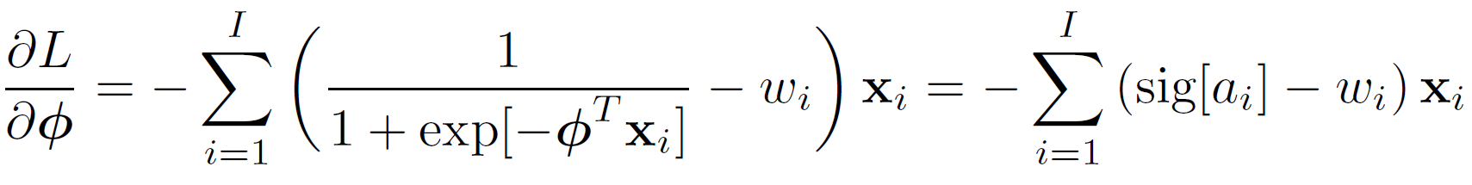

Maximum Likelihood
Take logarithm
Take derivative:
Computer vision: models, learning and inference. ©2011 Simon J.D. Prince
9

Slide 10
Derivatives
Unfortunately, there is no closed form solution– we cannot get an expression for φ in terms of x and w
Have to use a general purpose technique:
“iterative non-linear optimization”
Computer vision: models, learning and inference. ©2011 Simon J.D. Prince
10

Slide 11
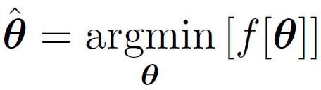
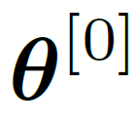
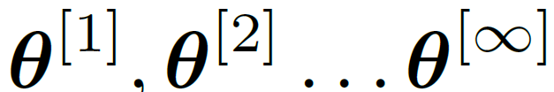
Optimization
Goal:
How can we find the minimum?
Basic idea:
Start with estimate
Take a series of small steps to
Make sure that each step decreases cost
When can’t improve, then must be at minimum
Cost function or
Objective function
Computer vision: models, learning and inference. ©2011 Simon J.D. Prince
11

Slide 12
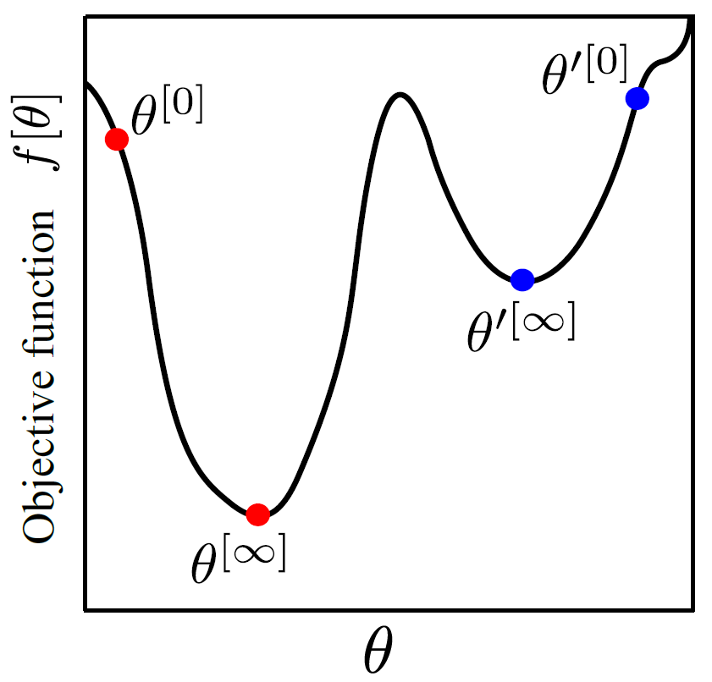
Local Minima
Computer vision: models, learning and inference. ©2011 Simon J.D. Prince
12

Slide 13
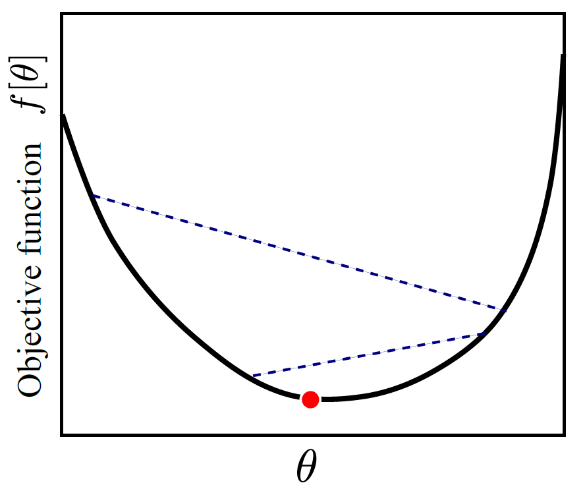





Convexity
If a function is convex, then it has only a single minimum.
Can tell if a function is convex by looking at 2nd derivatives
Computer vision: models, learning and inference. ©2011 Simon J.D. Prince
13

Slide 14
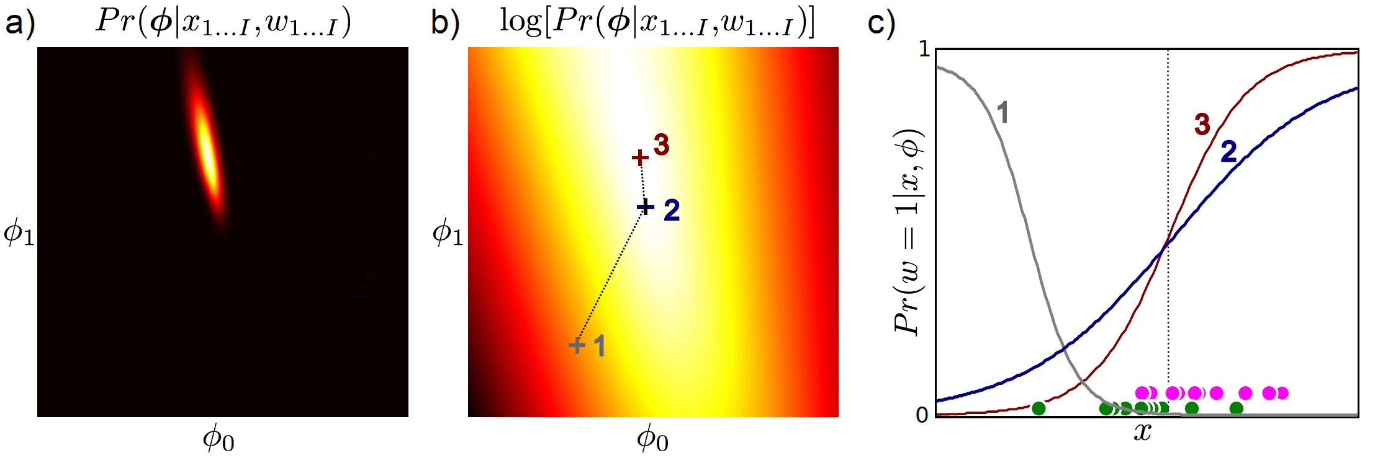




Computer vision: models, learning and inference. ©2011 Simon J.D. Prince
14

Slide 15
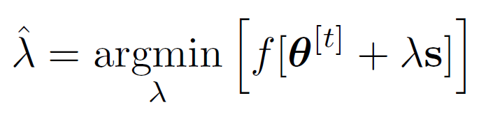
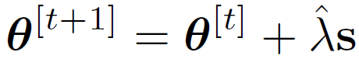



Gradient Based Optimization
Choose a search direction s based on the local properties of the function
Perform an intensive search along the chosen direction. This is called line search
Then set
Computer vision: models, learning and inference. ©2011 Simon J.D. Prince
15

Slide 16
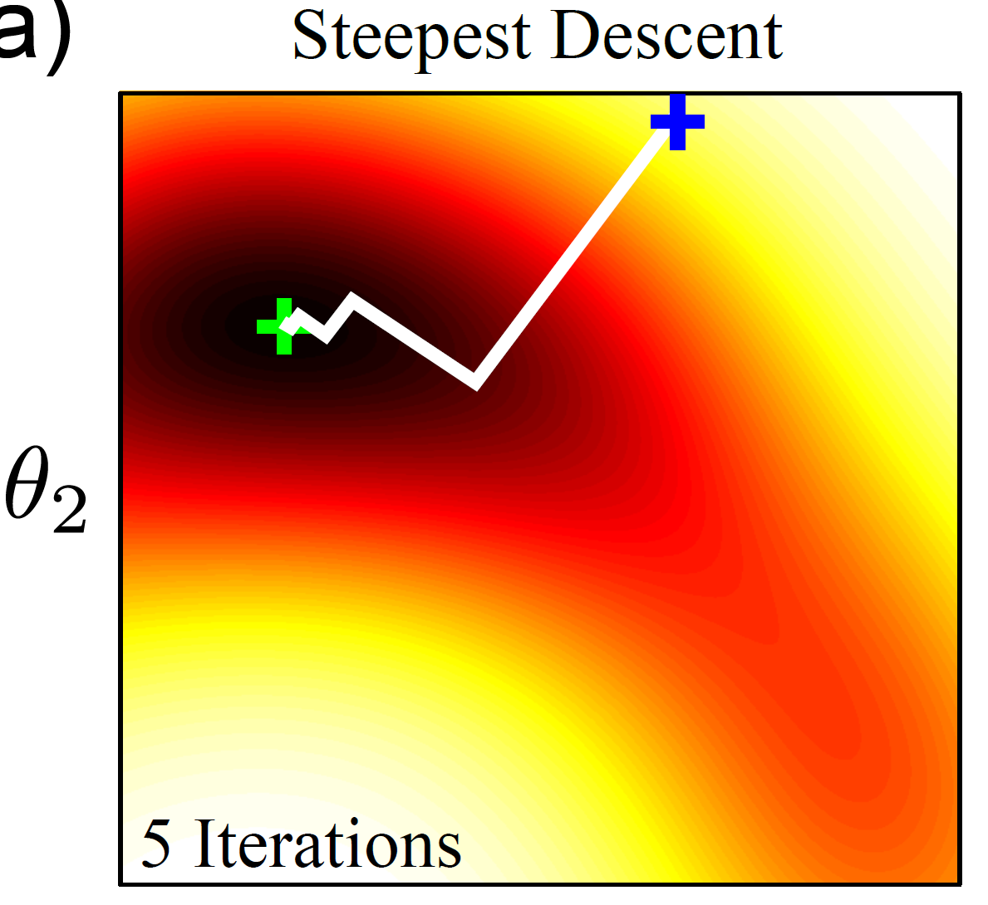
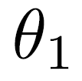



Gradient Descent
Consider standing on a hillside
Look at gradient where you are standing
Find the steepest direction downhill
Walk in that direction for some distance (line search)
Computer vision: models, learning and inference. ©2011 Simon J.D. Prince
16

Slide 17
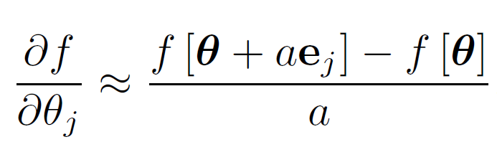





Finite differences
What if we can’t compute the gradient?
Compute finite difference approximation:
where e_{j} is the unit vector in the j^{th} direction
Computer vision: models, learning and inference. ©2011 Simon J.D. Prince
17

Slide 18
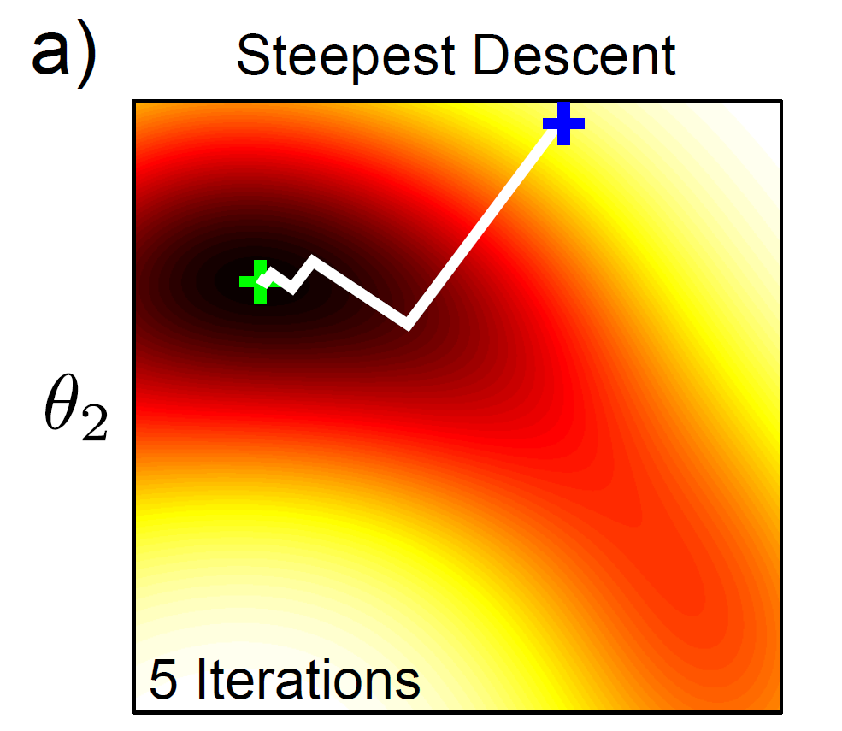
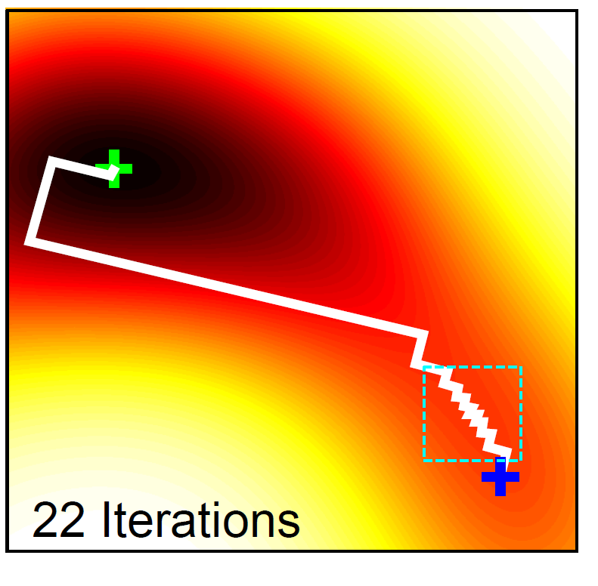
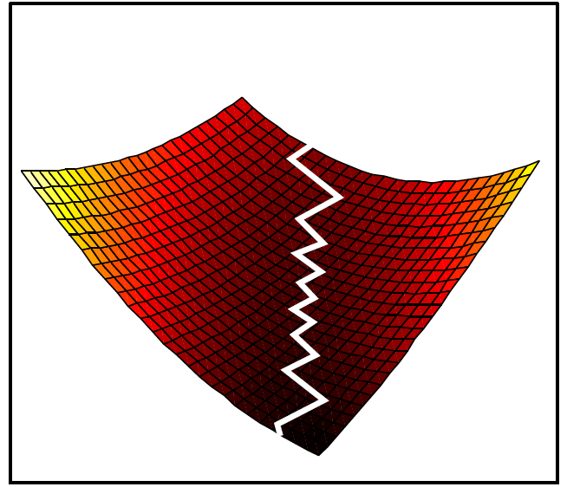
Steepest Descent Problems
Close up
Computer vision: models, learning and inference. ©2011 Simon J.D. Prince
18

Slide 19
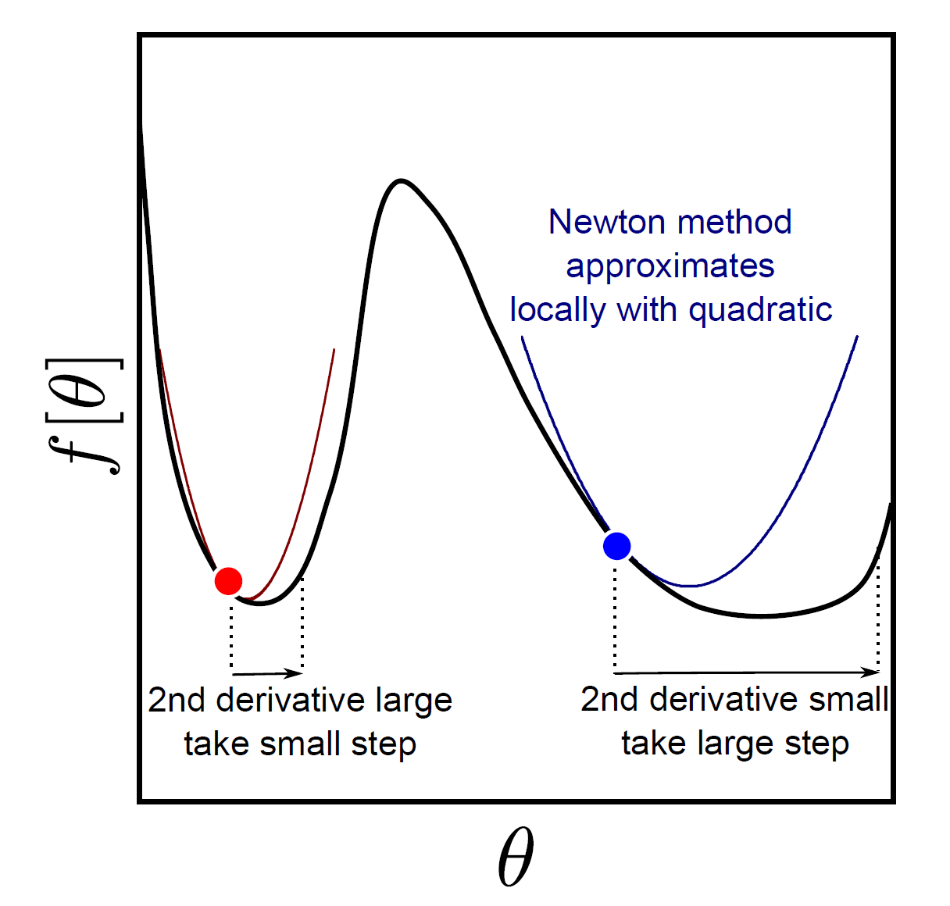






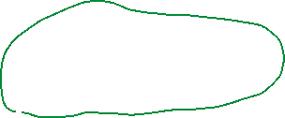


Second Derivatives
In higher dimensions, 2nd derivatives change how much we should move
in the different directions: changes best direction to move in.
Computer vision: models, learning and inference. ©2011 Simon J.D. Prince
19

Slide 20
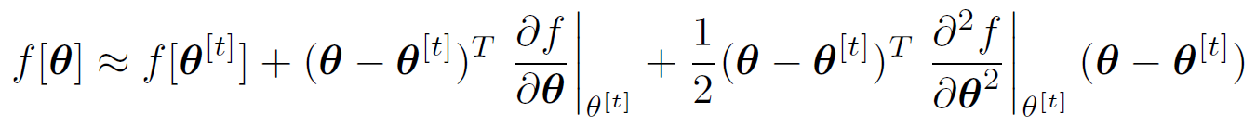
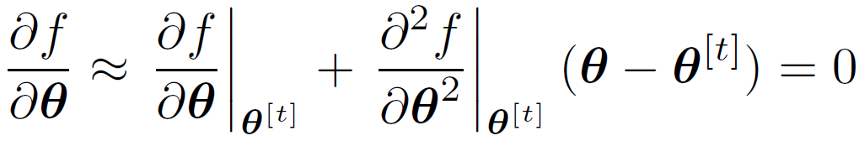
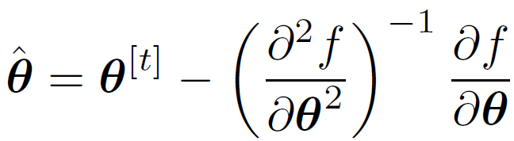
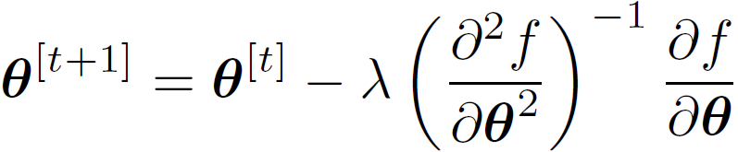




Newton’s Method
Approximate function with Taylor expansion
Take derivative
Re-arrange
Adding line search
Computer vision: models, learning and inference. ©2011 Simon J.D. Prince
20

Slide 21



Newton’s Method
Matrix of second derivatives is called the Hessian.
Expensive to compute via finite differences.
If positive definite, then convex
Computer vision: models, learning and inference. ©2011 Simon J.D. Prince
21

Slide 22
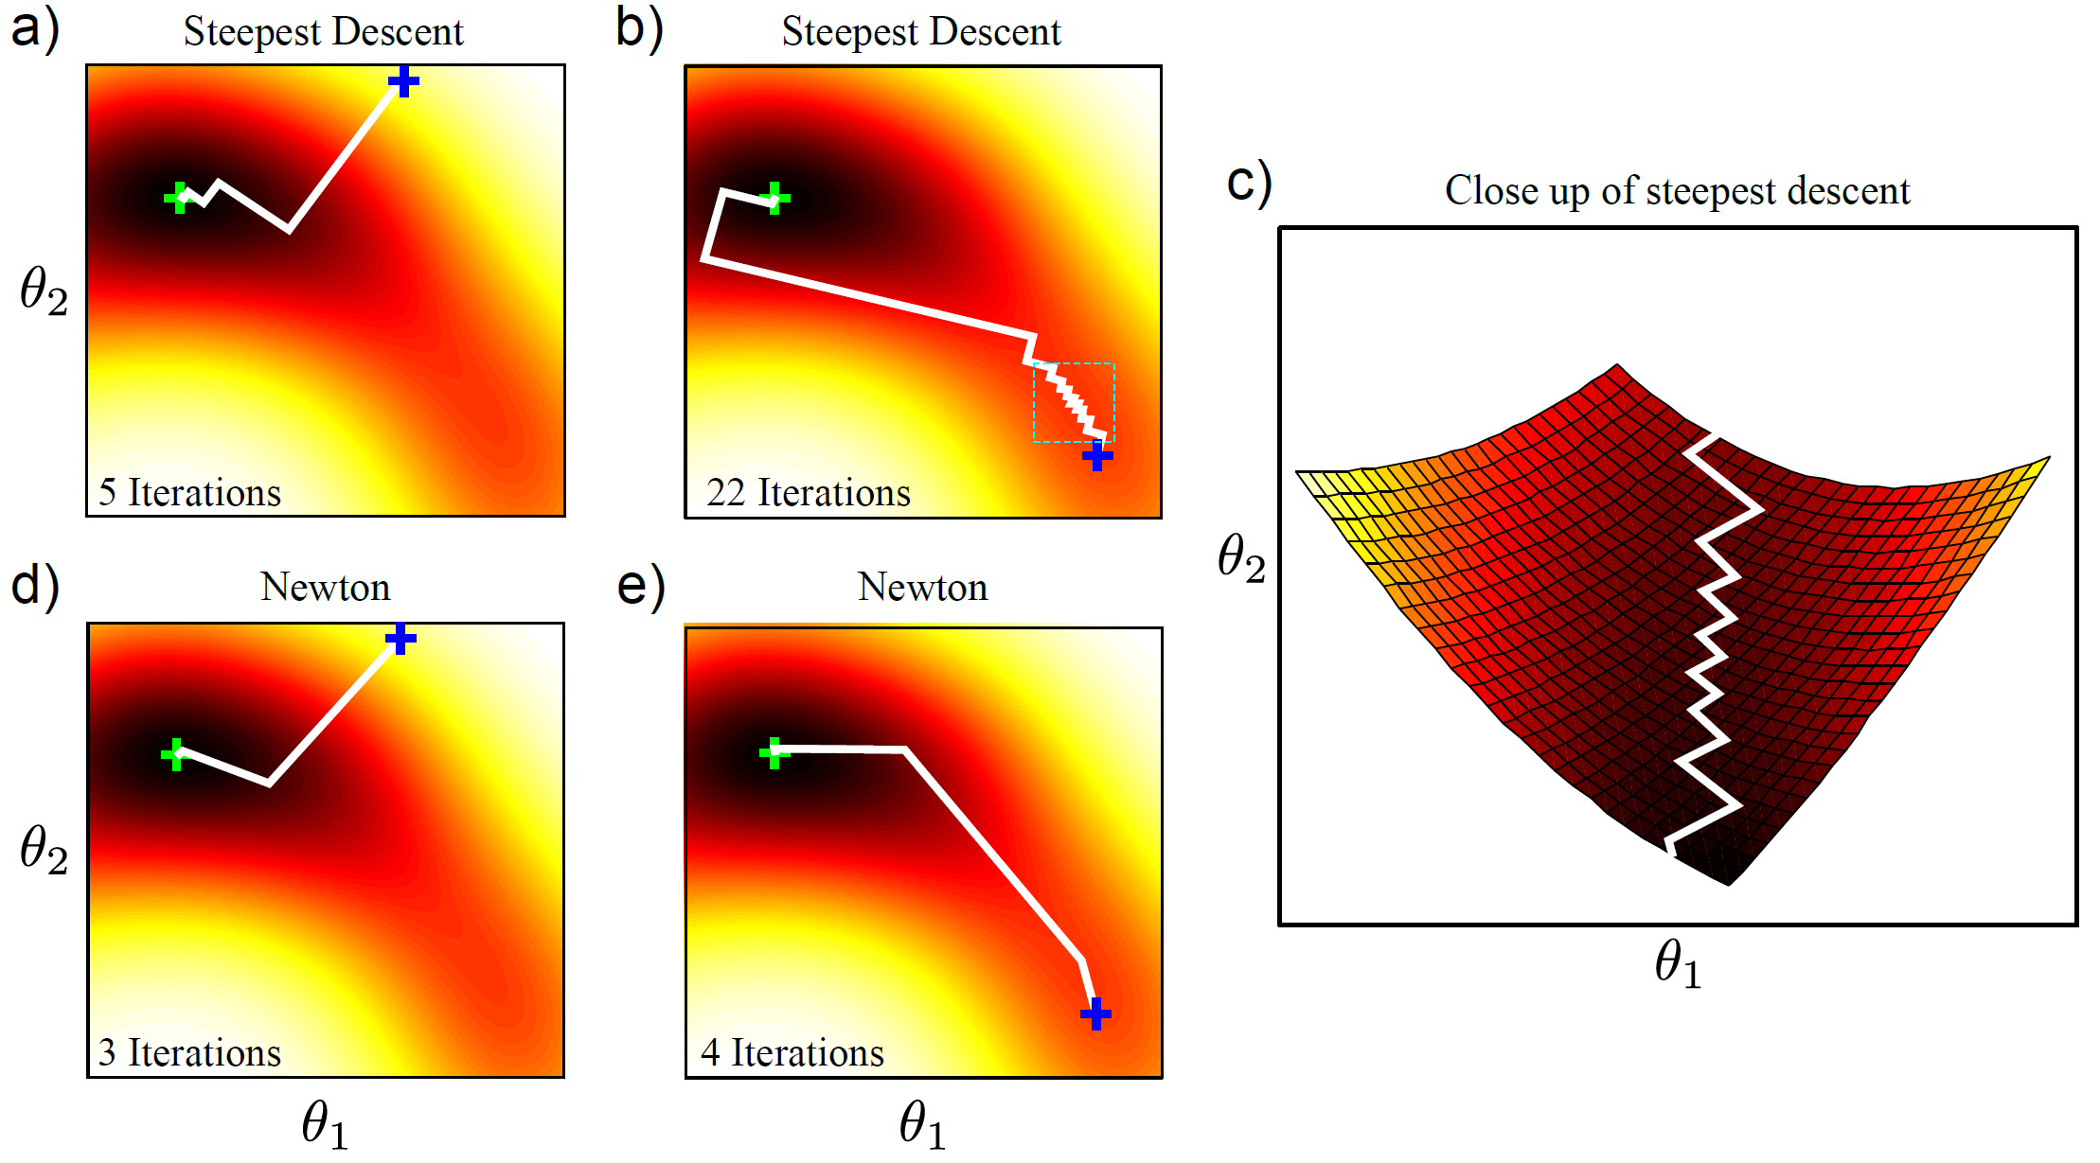


Newton vs. Steepest Descent
如果步长太大，可能导致在最小值附近震荡，甚至发散。
如果步长太小，虽然能保证稳定性，但会使收敛速度变慢。
Computer vision: models, learning and inference. ©2011 Simon J.D. Prince
22

Slide 23
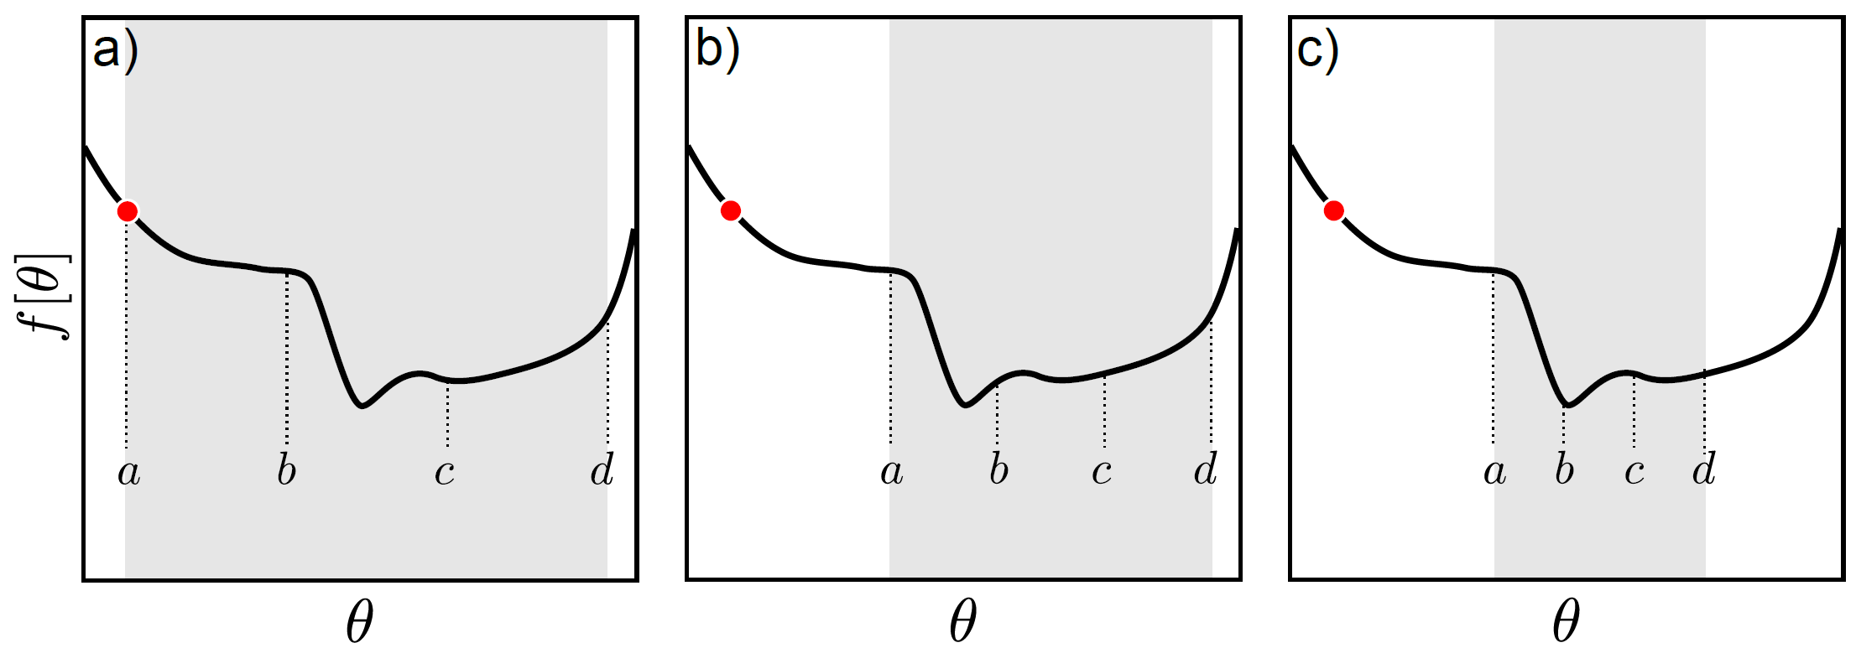


Line Search
Gradually narrow down range
Computer vision: models, learning and inference. ©2011 Simon J.D. Prince
23

Slide 24
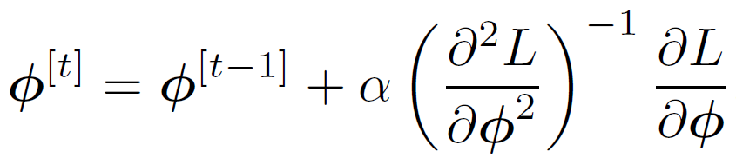
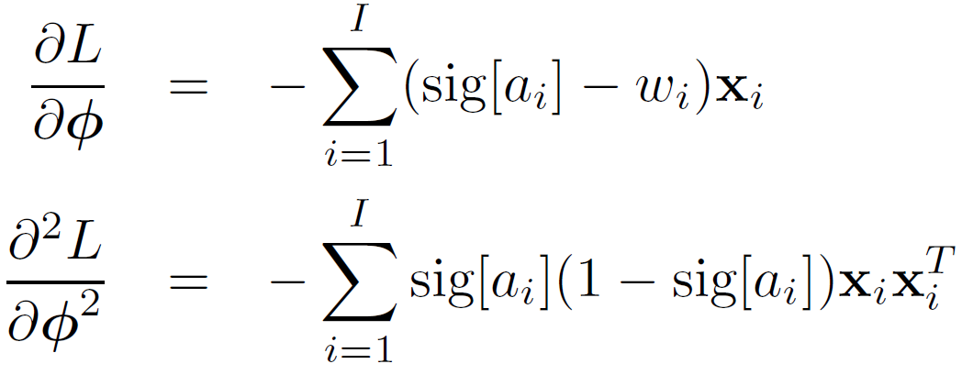



Optimization for Logistic Regression
Derivatives of log likelihood:
Positive definite!
Computer vision: models, learning and inference. ©2011 Simon J.D. Prince
24

Slide 25
Computer vision: models, learning and inference. ©2011 Simon J.D. Prince
25

Slide 26
Maximum likelihood fits
Computer vision: models, learning and inference. ©2011 Simon J.D. Prince
26

Slide 27
Structure
Logistic regression
Bayesian logistic regression
Non-linear logistic regression
Kernelization and Gaussian process classification
Incremental fitting, boosting and trees
Multi-class classification
Random classification trees
Non-probabilistic classification
Applications
Computer vision: models, learning and inference. ©2011 Simon J.D. Prince
27

Slide 28
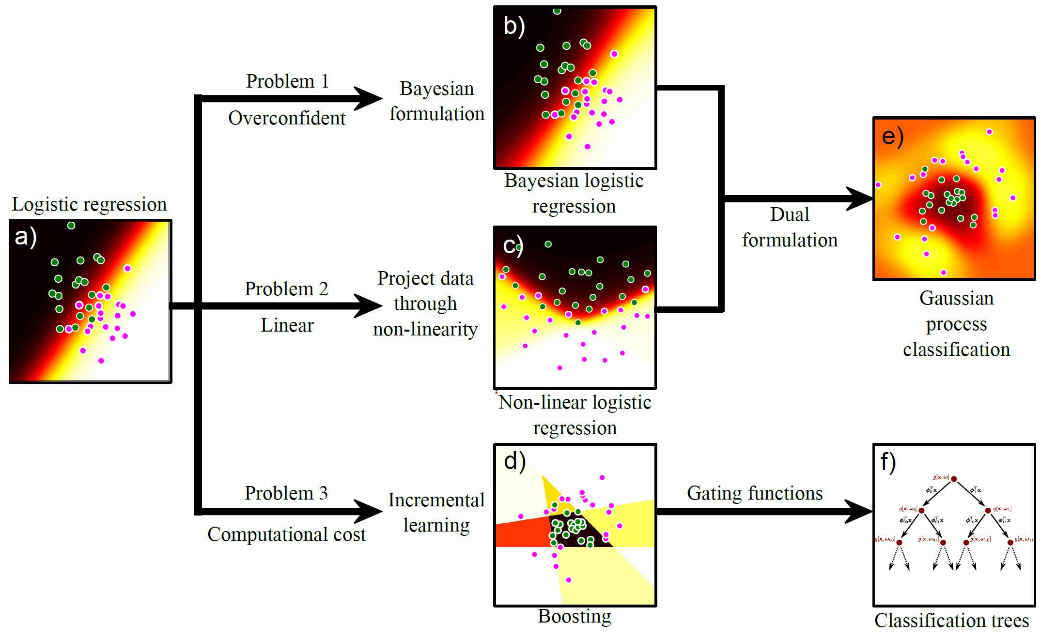

Computer vision: models, learning and inference. ©2011 Simon J.D. Prince
28

Slide 29
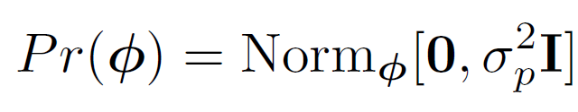
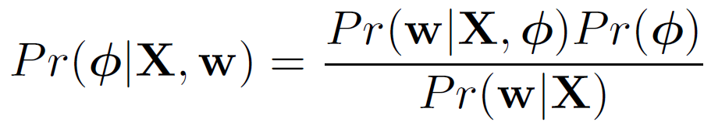
Bayesian Logistic Regression
Likelihood:
Prior (no conjugate):
Apply Bayes’ rule:
(no closed form solution for posterior)
Computer vision: models, learning and inference. ©2011 Simon J.D. Prince
29

Slide 30
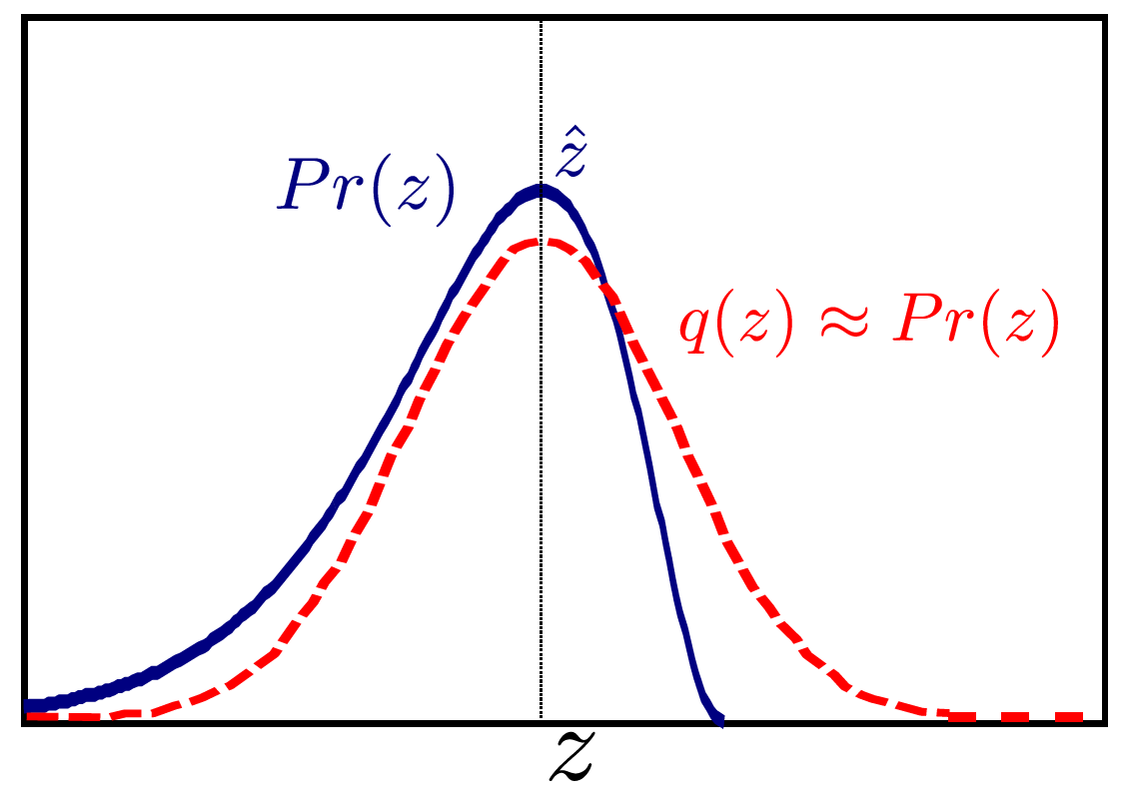

Laplace Approximation
Approximate posterior distribution with normal
Set mean to MAP estimate
Set covariance to match that at MAP estimate (actually: get 2nd derivatives to agree)
Computer vision: models, learning and inference. ©2011 Simon J.D. Prince
30

Slide 31
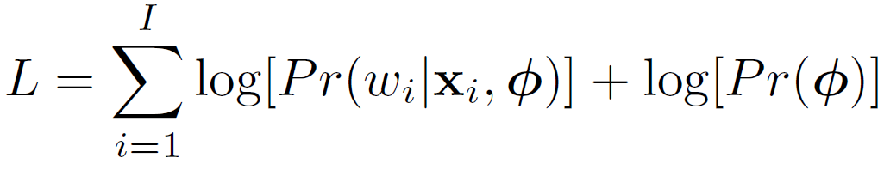
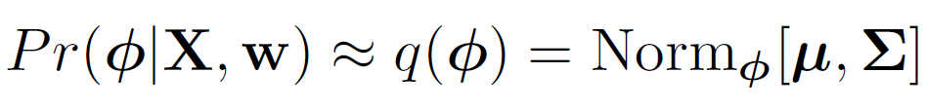
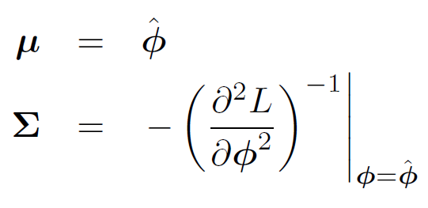
Laplace Approximation
Find MAP solution by optimizing log “posterior”
Approximate with normal
where
Computer vision: models, learning and inference. ©2011 Simon J.D. Prince
31

Slide 32
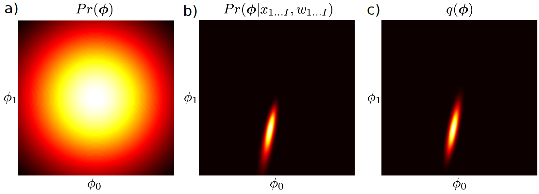
Laplace Approximation
Prior
Actual posterior
Approximated
Computer vision: models, learning and inference. ©2011 Simon J.D. Prince
32

Slide 33
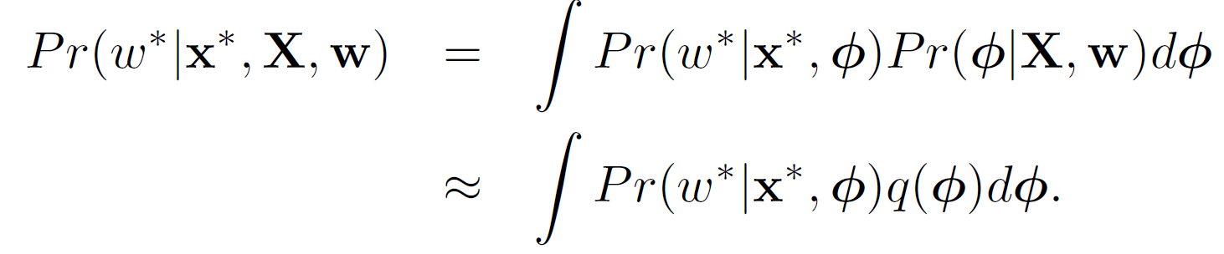
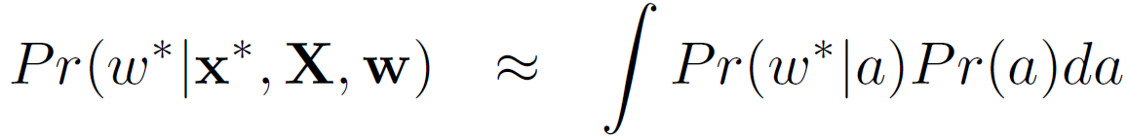

Inference
Can re-express in terms of activation
Using transformation properties of normal distributions
Computer vision: models, learning and inference. ©2011 Simon J.D. Prince
33

Slide 34


Approximation of Integral
(Or perform numerical integration on a – which is 1D)
Computer vision: models, learning and inference. ©2011 Simon J.D. Prince
34

Slide 35

Bayesian Solution
Computer vision: models, learning and inference. ©2011 Simon J.D. Prince
35

Slide 36
Structure
Logistic regression
Bayesian logistic regression
Non-linear logistic regression
Kernelization and Gaussian process classification
Incremental fitting, boosting and trees
Multi-class classification
Random classification trees
Non-probabilistic classification
Applications
Computer vision: models, learning and inference. ©2011 Simon J.D. Prince
36

Slide 37
Computer vision: models, learning and inference. ©2011 Simon J.D. Prince
37

Slide 38

Non-linear logistic regression
Same idea as for regression.
Apply non-linear transformation
Build model as usual
Computer vision: models, learning and inference. ©2011 Simon J.D. Prince
38

Slide 39







Non-linear logistic regression
Example transformations:
Fit using optimization (also transformation parameters α):
Computer vision: models, learning and inference. ©2011 Simon J.D. Prince
39

Slide 40

Non-linear logistic regression in 1D
Weights after applying ML
Final activation
sig[Final activation]
Computer vision: models, learning and inference. ©2011 Simon J.D. Prince
40

Slide 41

Non-linear logistic regression in 2D
Computer vision: models, learning and inference. ©2011 Simon J.D. Prince
41

Slide 42
Structure
Logistic regression
Bayesian logistic regression
Non-linear logistic regression
Kernelization and Gaussian process classification
Incremental fitting, boosting and trees
Multi-class classification
Random classification trees
Non-probabilistic classification
Applications
Computer vision: models, learning and inference. ©2011 Simon J.D. Prince
42

Slide 43
Computer vision: models, learning and inference. ©2011 Simon J.D. Prince
43

Slide 44












Dual Logistic Regression
KEY IDEA:
Gradient Φ is just a vector in the data space
Can represent as a weighted sum of the data points
Now solve for Ψ. One parameter per training example.
Computer vision: models, learning and inference. ©2011 Simon J.D. Prince
44

Slide 45




Maximum Likelihood
Likelihood
Derivatives
Only depend on inner products!
Computer vision: models, learning and inference. ©2011 Simon J.D. Prince
45

Slide 46


Kernel Logistic Regression
Computer vision: models, learning and inference. ©2011 Simon J.D. Prince
46

Slide 47


ML vs. Bayesian
Bayesian case is known as Gaussian process classification
Computer vision: models, learning and inference. ©2011 Simon J.D. Prince
47

Slide 48



Relevance vector classification
Apply sparse prior to dual variables:
As before, write as marginalization of dual variables:
Computer vision: models, learning and inference. ©2011 Simon J.D. Prince
48

Slide 49

Relevance vector classification
Apply sparse prior to dual variables:
Gives model:
Computer vision: models, learning and inference. ©2011 Simon J.D. Prince
49

Slide 50


Relevance vector classification
Need two approximations:
#1: Use Laplace approximation result:
giving:
Computer vision: models, learning and inference. ©2011 Simon J.D. Prince
50

Slide 51


Relevance vector classification
Previous result:
#2 approximation: maximize over H, instead of marginalizing:
To solve, alternately update hidden variables in H and mean and variance of Laplace approximation.
Computer vision: models, learning and inference. ©2011 Simon J.D. Prince
51

Slide 52


Relevance vector classification
Results:
Most hidden variables increase to larger values
This means prior over dual variable is very tight around zero
The final solution only depends on a very small number of examples – efficient
Computer vision: models, learning and inference. ©2011 Simon J.D. Prince
52

Slide 53
Structure
Logistic regression
Bayesian logistic regression
Non-linear logistic regression
Kernelization and Gaussian process classification
Incremental fitting & boosting
Multi-class classification
Random classification trees
Non-probabilistic classification
Applications
Computer vision: models, learning and inference. ©2011 Simon J.D. Prince
53

Slide 54
Computer vision: models, learning and inference. ©2011 Simon J.D. Prince
54

Slide 55







Incremental Fitting
Previously wrote:
Now write:
Computer vision: models, learning and inference. ©2011 Simon J.D. Prince
55

Slide 56




Incremental Fitting
KEY IDEA: Greedily add terms one at a time.
STAGE 1: Fit φ₀, φ₁, ξ₁
STAGE 2: Fit φ₀, φ₂, ξ₂
STAGE K: Fit φ₀, φ_{k}, ξ_{k}
Computer vision: models, learning and inference. ©2011 Simon J.D. Prince
56

Slide 57


Incremental Fitting
Computer vision: models, learning and inference. ©2011 Simon J.D. Prince
57

Slide 58

Derivative
It is worth considering the form of the derivative in the context of the incremental fitting procedure
Actual label
Predicted Label
Points contribute to derivative more if they are still misclassified: the later classifiers become increasingly specialized to the difficult examples.
Computer vision: models, learning and inference. ©2011 Simon J.D. Prince
58

Slide 59



Boosting
Incremental fitting with step functions
Each step function is called a ``weak classifier``
Can’t take derivative w.r.t α so have to just use exhaustive search
Computer vision: models, learning and inference. ©2011 Simon J.D. Prince
59

Slide 60

Boosting
Computer vision: models, learning and inference. ©2011 Simon J.D. Prince
60

Slide 61

Branching Logistic Regression
A different way to make non-linear classifiers
New activation
The term is a gating function.
Returns a number between 0 and 1
If 0, then we get one logistic regression model
If 1, then get a different logistic regression model
Computer vision: models, learning and inference. ©2011 Simon J.D. Prince
61

Slide 62

Branching Logistic Regression
Computer vision: models, learning and inference. ©2011 Simon J.D. Prince
62

Slide 63

Logistic Classification Trees
Computer vision: models, learning and inference. ©2011 Simon J.D. Prince
63

Slide 64
Structure
Logistic regression
Bayesian logistic regression
Non-linear logistic regression
Kernelization and Gaussian process classification
Incremental fitting, boosting and trees
Multi-class classification
Random classification trees
Non-probabilistic classification
Applications
Computer vision: models, learning and inference. ©2011 Simon J.D. Prince
64

Slide 65



Multiclass Logistic Regression
For multiclass recognition, choose distribution over w and make the parameters of this a function of x.
Softmax function maps real activations {a_{k}} to numbers between zero and one that sum to one
Parameters are vectors {φ_{k}}
Computer vision: models, learning and inference. ©2011 Simon J.D. Prince
65

Slide 66

Multiclass Logistic Regression
Softmax function maps activations which can take any value to parameters of categorical distribution between 0 and 1
Computer vision: models, learning and inference. ©2011 Simon J.D. Prince
66

Slide 67


Multiclass Logistic Regression
To learn model, maximize log likelihood
No closed from solution, learn with non-linear optimization
where
Computer vision: models, learning and inference. ©2011 Simon J.D. Prince
67

Slide 68
Structure
Logistic regression
Bayesian logistic regression
Non-linear logistic regression
Kernelization and Gaussian process classification
Incremental fitting, boosting and trees
Multi-class classification
Random classification trees
Non-probabilistic classification
Applications
Computer vision: models, learning and inference. ©2011 Simon J.D. Prince
68

Slide 69


Random classification tree
Key idea:
Binary tree
Randomly chosen function at each split
Choose threshold t to maximize log probability
For given threshold, can compute parameters in closed form
Computer vision: models, learning and inference. ©2011 Simon J.D. Prince
69

Slide 70
Random classification tree
Related models:
Fern:
A tree where all of the functions at a level are the same
Thresholds per level may be same or different
Very efficient to implement
Forest
Collection of trees
Average results to get more robust answer
Similar to `Bayesian’ approach – average of models with different parameters
Computer vision: models, learning and inference. ©2011 Simon J.D. Prince
70

Slide 71
Structure
Logistic regression
Bayesian logistic regression
Non-linear logistic regression
Kernelization and Gaussian process classification
Incremental fitting, boosting and trees
Multi-class classification
Random classification trees
Non-probabilistic classification
Applications
Computer vision: models, learning and inference. ©2011 Simon J.D. Prince
71

Slide 72
Non-probabilistic classifiers
Most people use non-probabilistic classification methods such as neural networks, adaboost, support vector machines. This is largely for historical reasons
Probabilistic approaches:
No serious disadvantages
Naturally produce estimates of uncertainty
Easily extensible to multi-class case
Easily related to each other
Computer vision: models, learning and inference. ©2011 Simon J.D. Prince
72

Slide 73
Non-probabilistic classifiers
Multi-layer perceptron (neural network)
Non-linear logistic regression with sigmoid functions
Learning known as back propagation
Transformed variable z is hidden layer
Adaboost
Very closely related to logitboost
Performance very similar
Support vector machines
Similar to relevance vector classification but objective fn is convex
No certainty
Not easily extended to multi-class
Produces solutions that are less sparse
More restrictions on kernel function
Computer vision: models, learning and inference. ©2011 Simon J.D. Prince
73

Slide 74
Structure
Logistic regression
Bayesian logistic regression
Non-linear logistic regression
Kernelization and Gaussian process classification
Incremental fitting, boosting and trees
Multi-class classification
Random classification trees
Non-probabilistic classification
Applications
Computer vision: models, learning and inference. ©2011 Simon J.D. Prince
74

Slide 75



Gender Classification
Incremental logistic regression
300 arc tan basis functions:
Results: 87.5% (humans=95%)
Computer vision: models, learning and inference. ©2011 Simon J.D. Prince
75

Slide 76

Fast Face Detection (Viola and Jones 2001)
Computer vision: models, learning and inference. ©2011 Simon J.D. Prince
76

Slide 77

Computing Haar Features
(See “Integral Images” or summed-area tables)
Computer vision: models, learning and inference. ©2011 Simon J.D. Prince
77

Slide 78

Pedestrian Detection
Computer vision: models, learning and inference. ©2011 Simon J.D. Prince
78

Slide 79


Semantic segmentation
Computer vision: models, learning and inference. ©2011 Simon J.D. Prince
79

Slide 80

Recovering surface layout
Computer vision: models, learning and inference. ©2011 Simon J.D. Prince
80

Slide 81

Recovering body pose
Computer vision: models, learning and inference. ©2011 Simon J.D. Prince
81

